Slide 1


First Day of Class:
Campus Crime Data
Materials: www.bikeprof.com/nicar15
Associate Professor Norm Lewis
www.bikeprof.com / @bikeprof

Slide 2

Course objective: Develop a data frame of mind

Slide 3
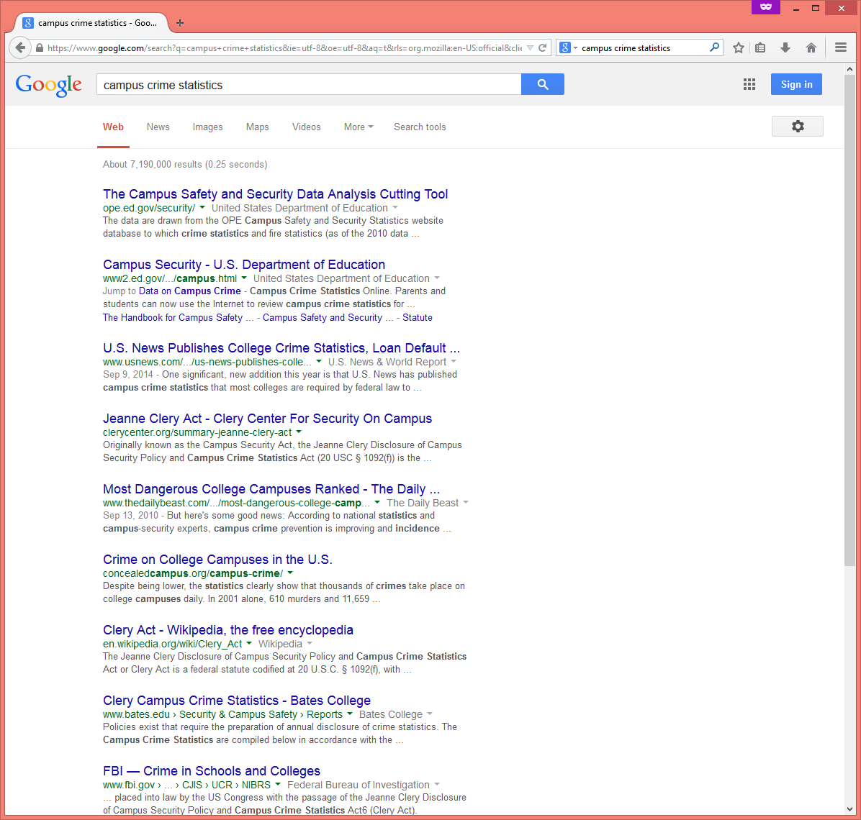
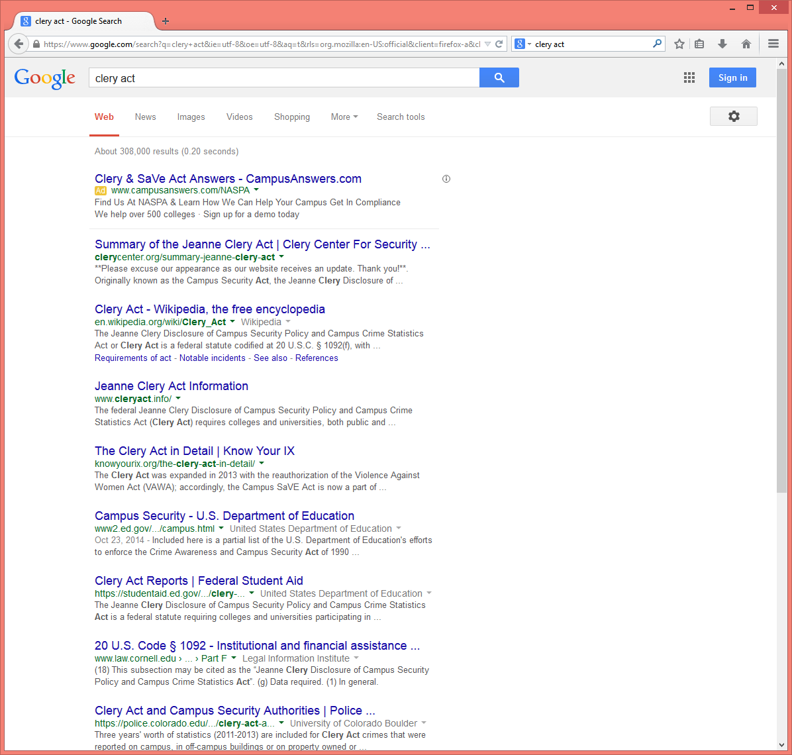

Slide 4
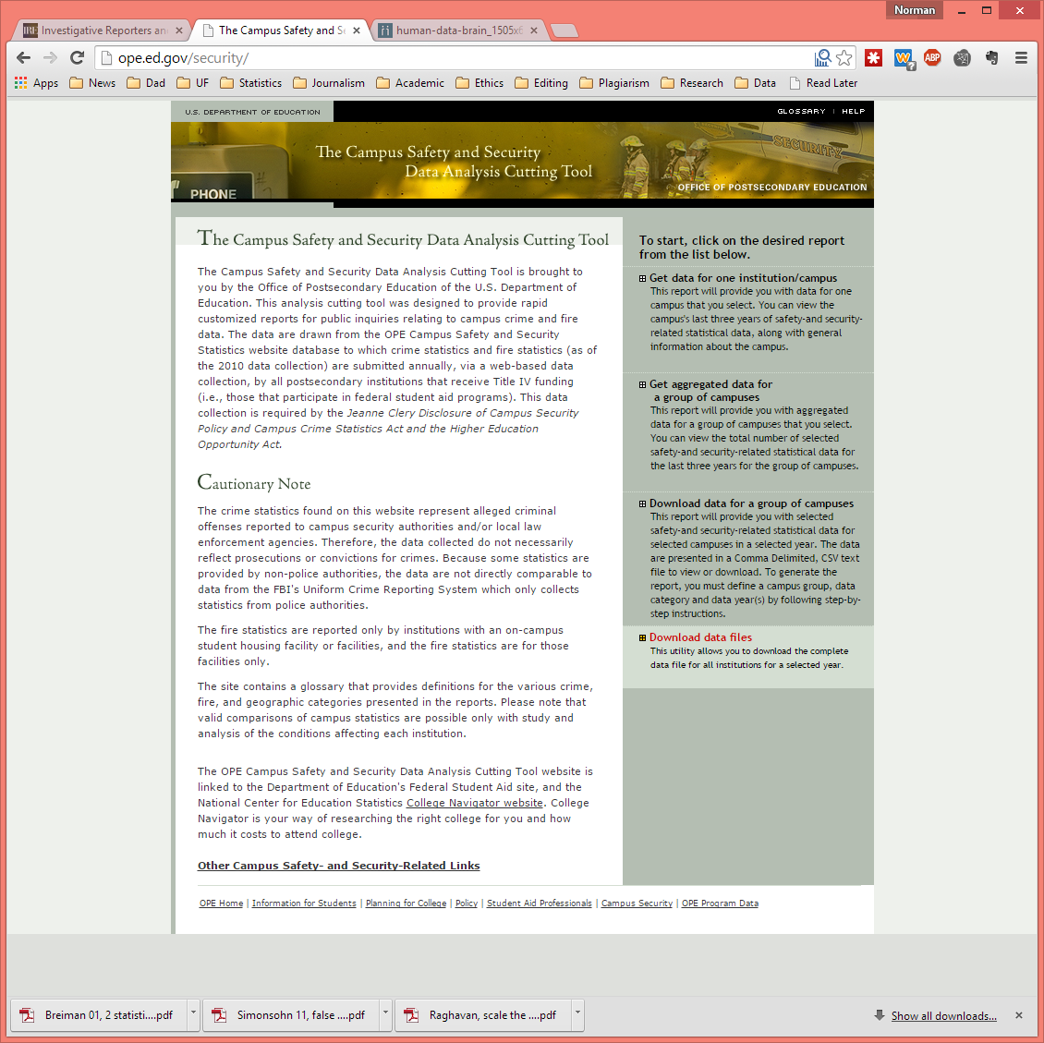
ope.ed.gov/security

Slide 5
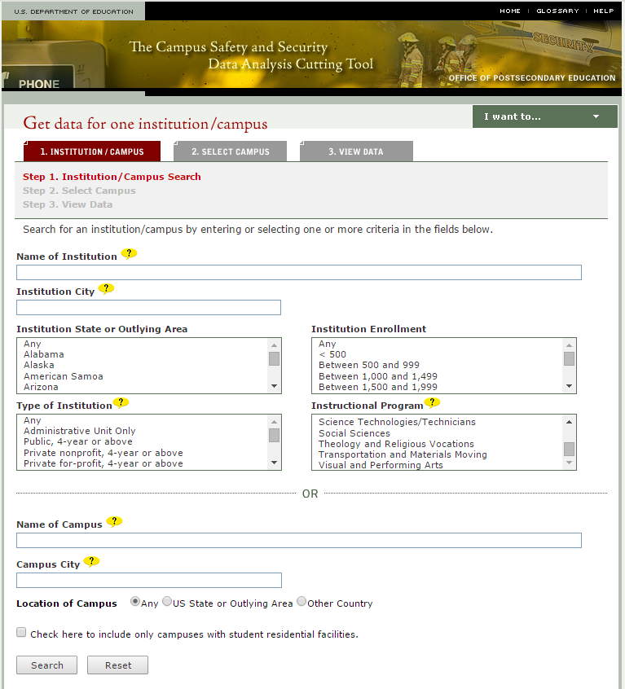

Slide 6
Download a zip file

Slide 7
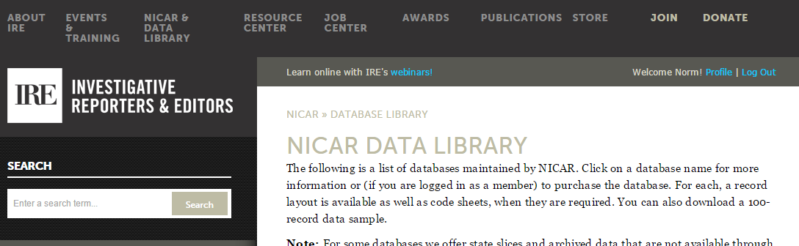
And now a word from our sponsors

Slide 8
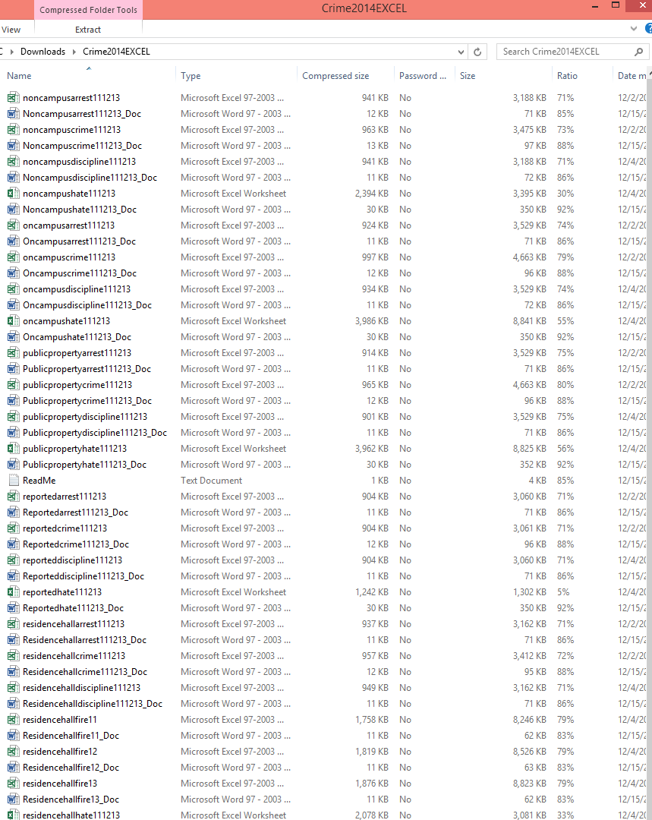
oncampuscrime

Slide 9
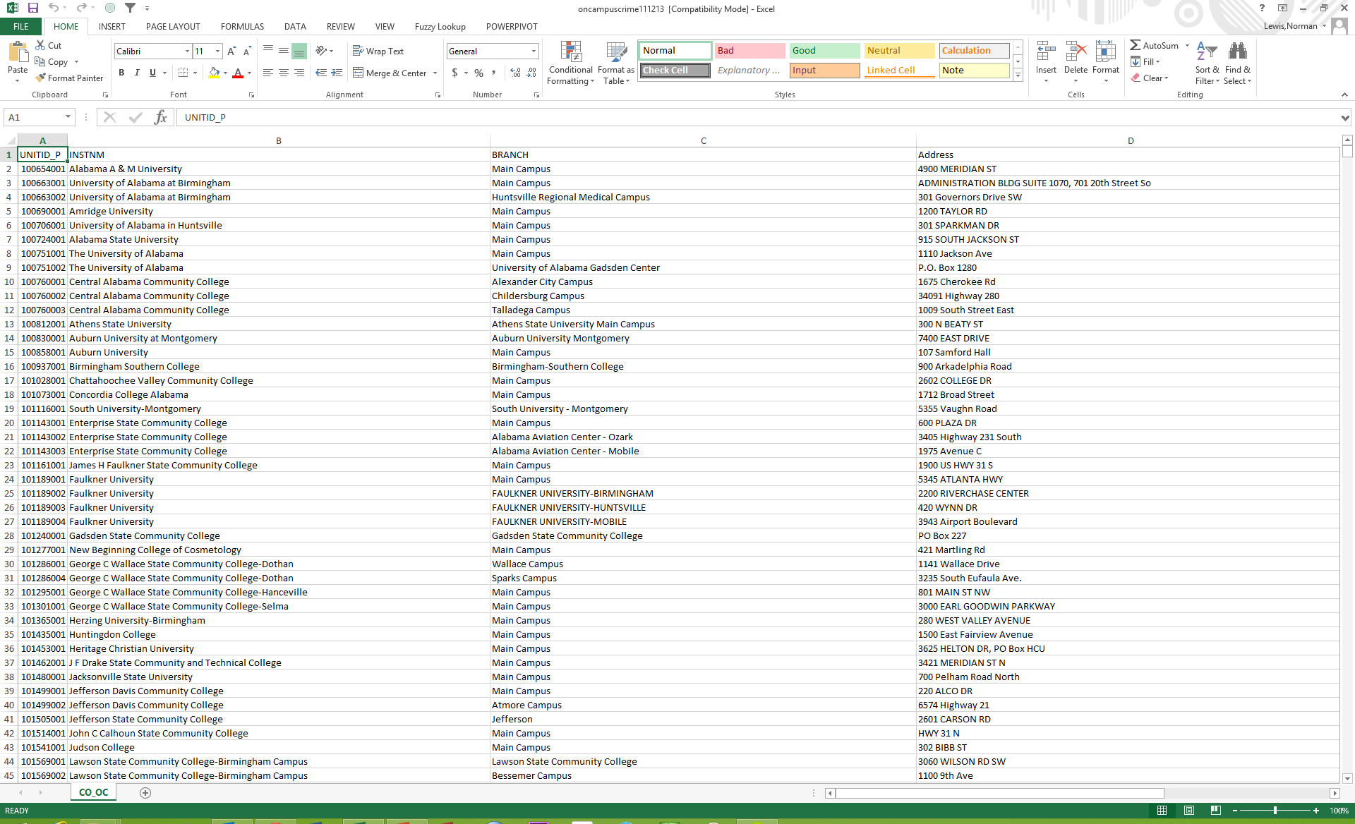

Slide 10
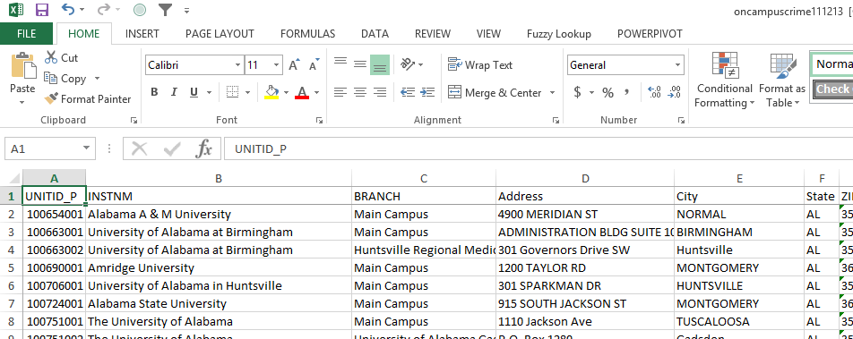
Navigating Excel: the cell, column widths, freeze

Slide 11
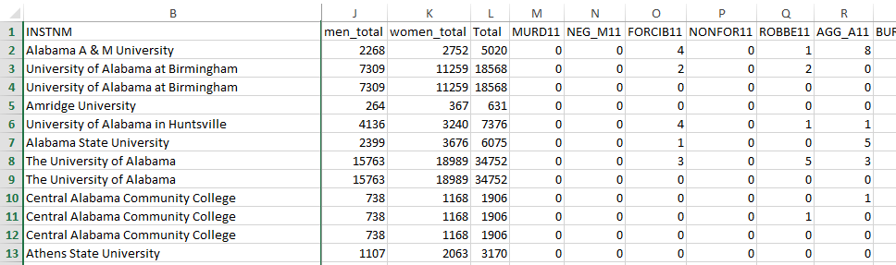
What are these strange column headings?

Slide 12
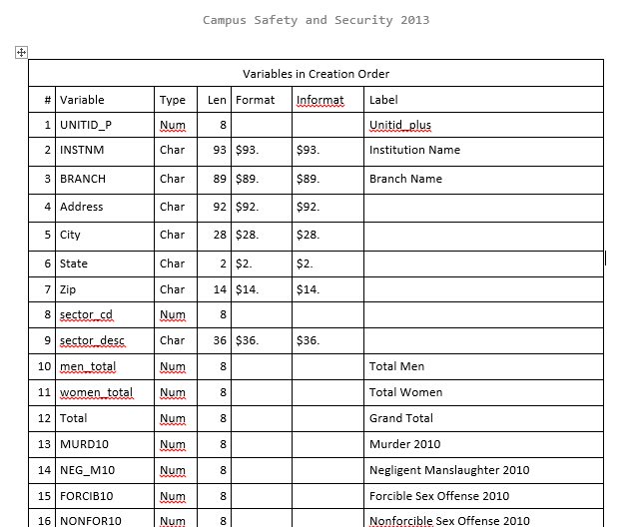
Data dictionary

Slide 13
Campus sexual assaults

Slide 14
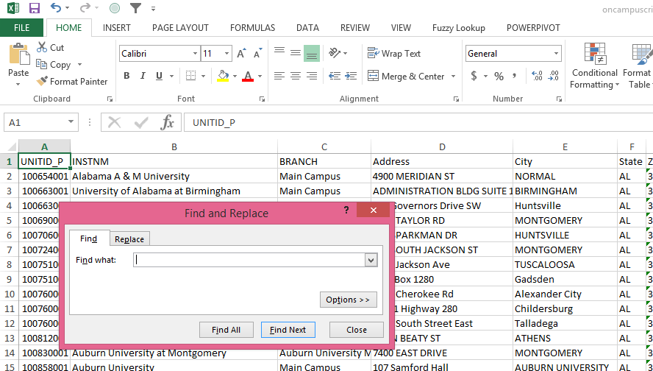
Finding Florida: Use search?

Slide 15
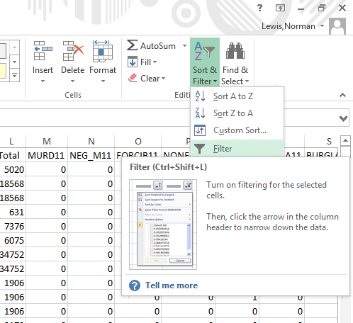

Slide 16
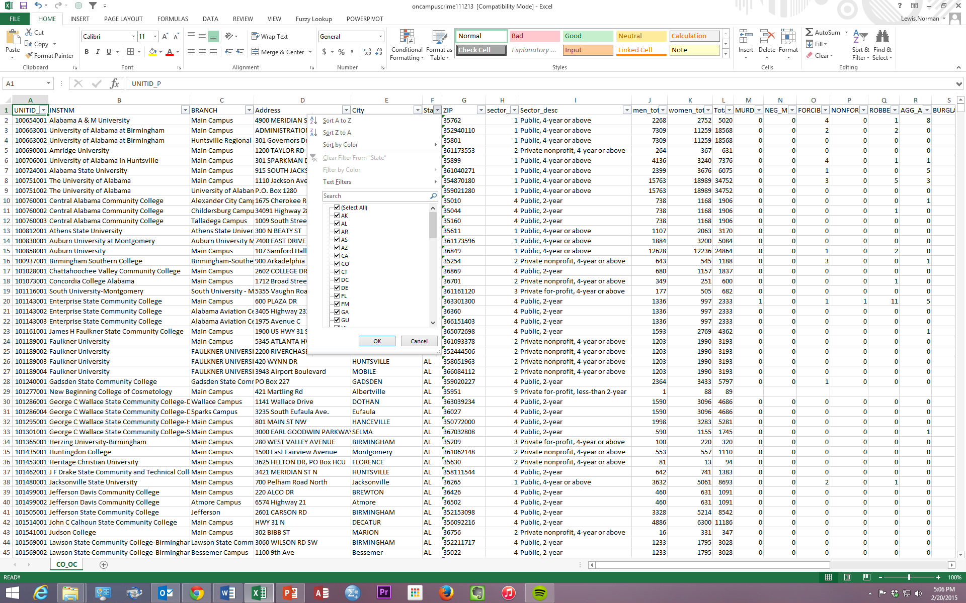
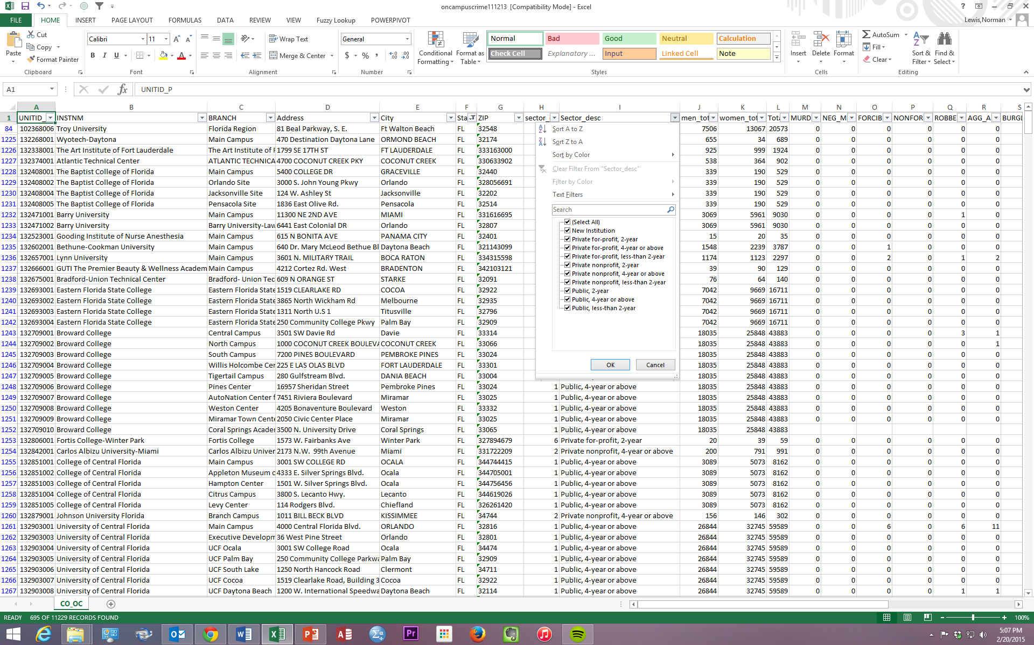

Slide 17
Fair comparison?

Slide 18
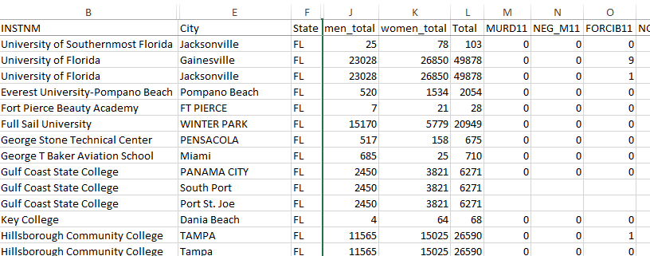
Are data consistent?
(Some columns hidden)

Slide 19


Slide 20
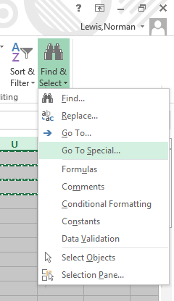
Copy filtered data into a new sheet

Slide 21
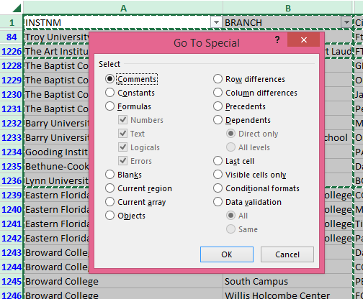
Copy filtered data into a new sheet

Slide 22
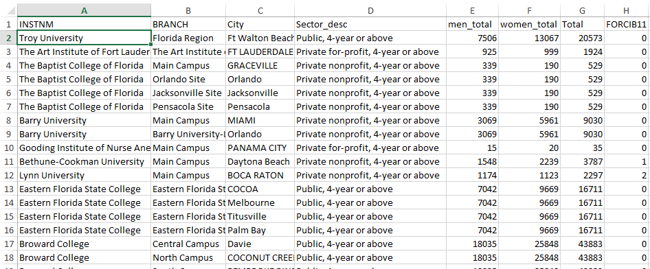
Next, sort data

Slide 23
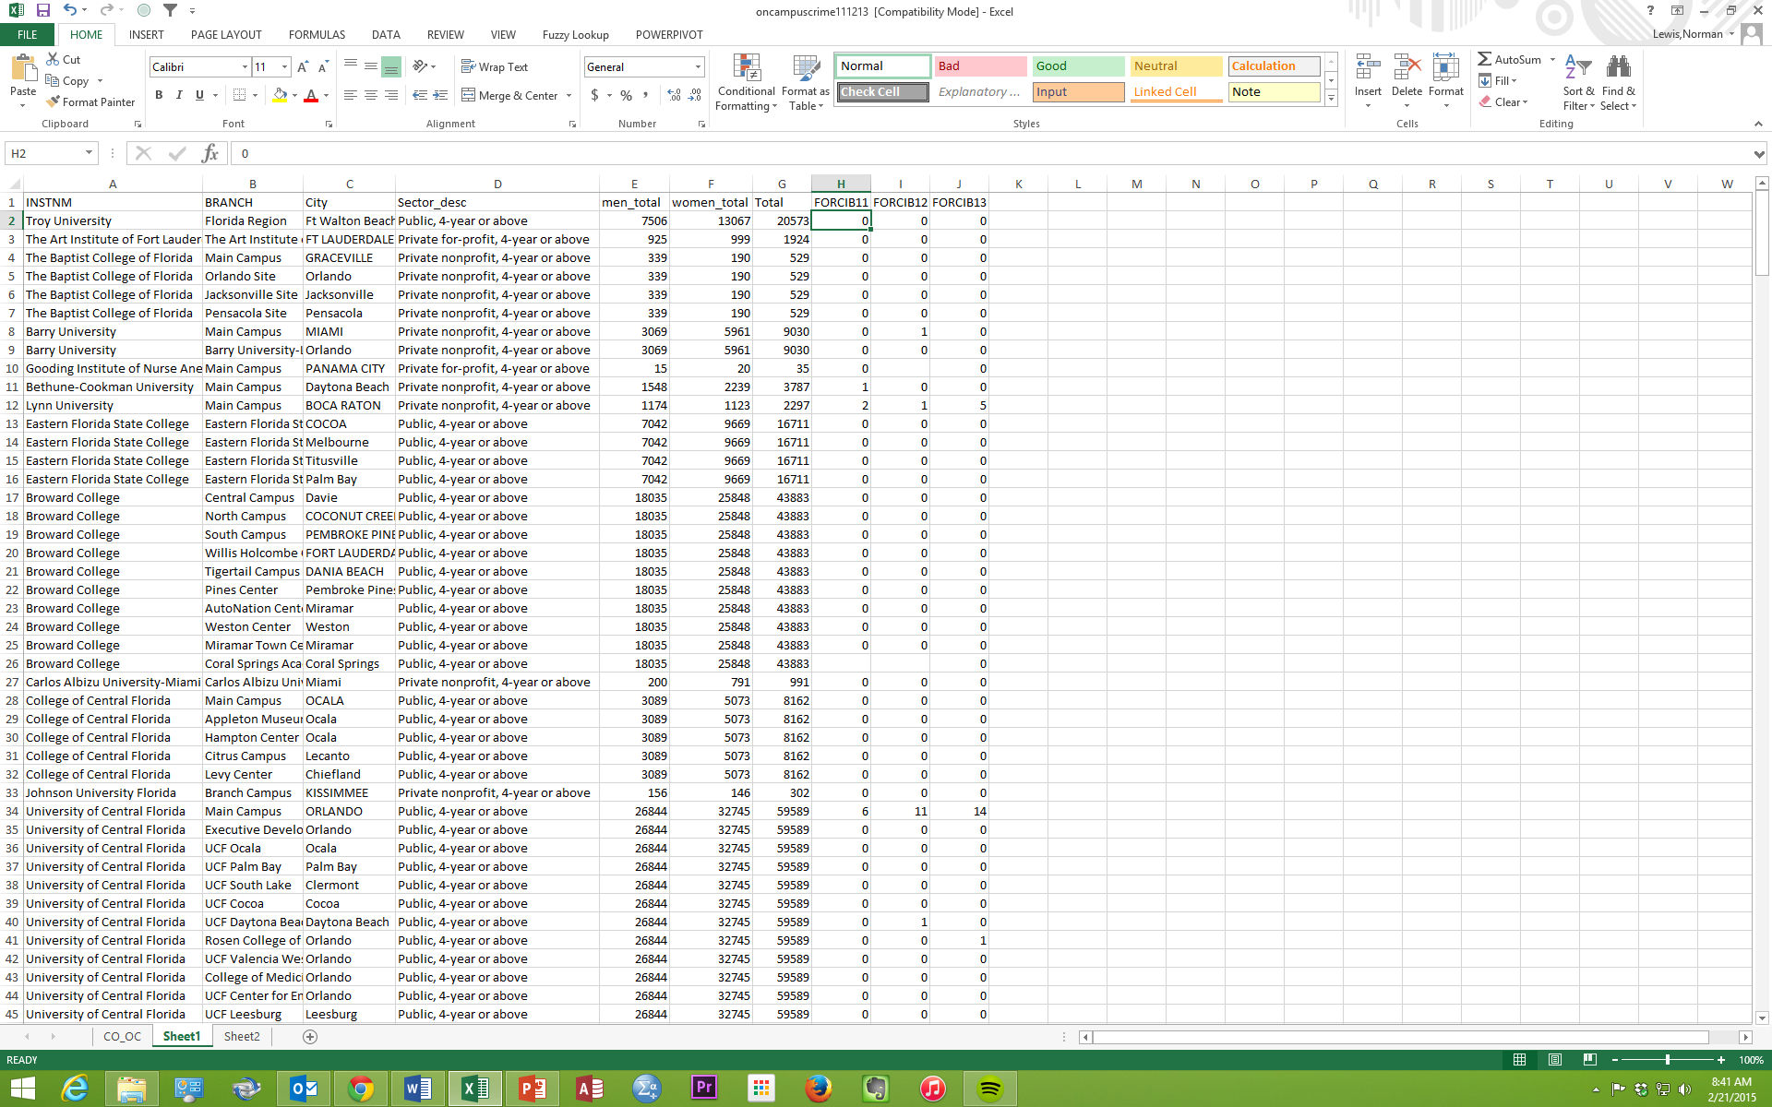
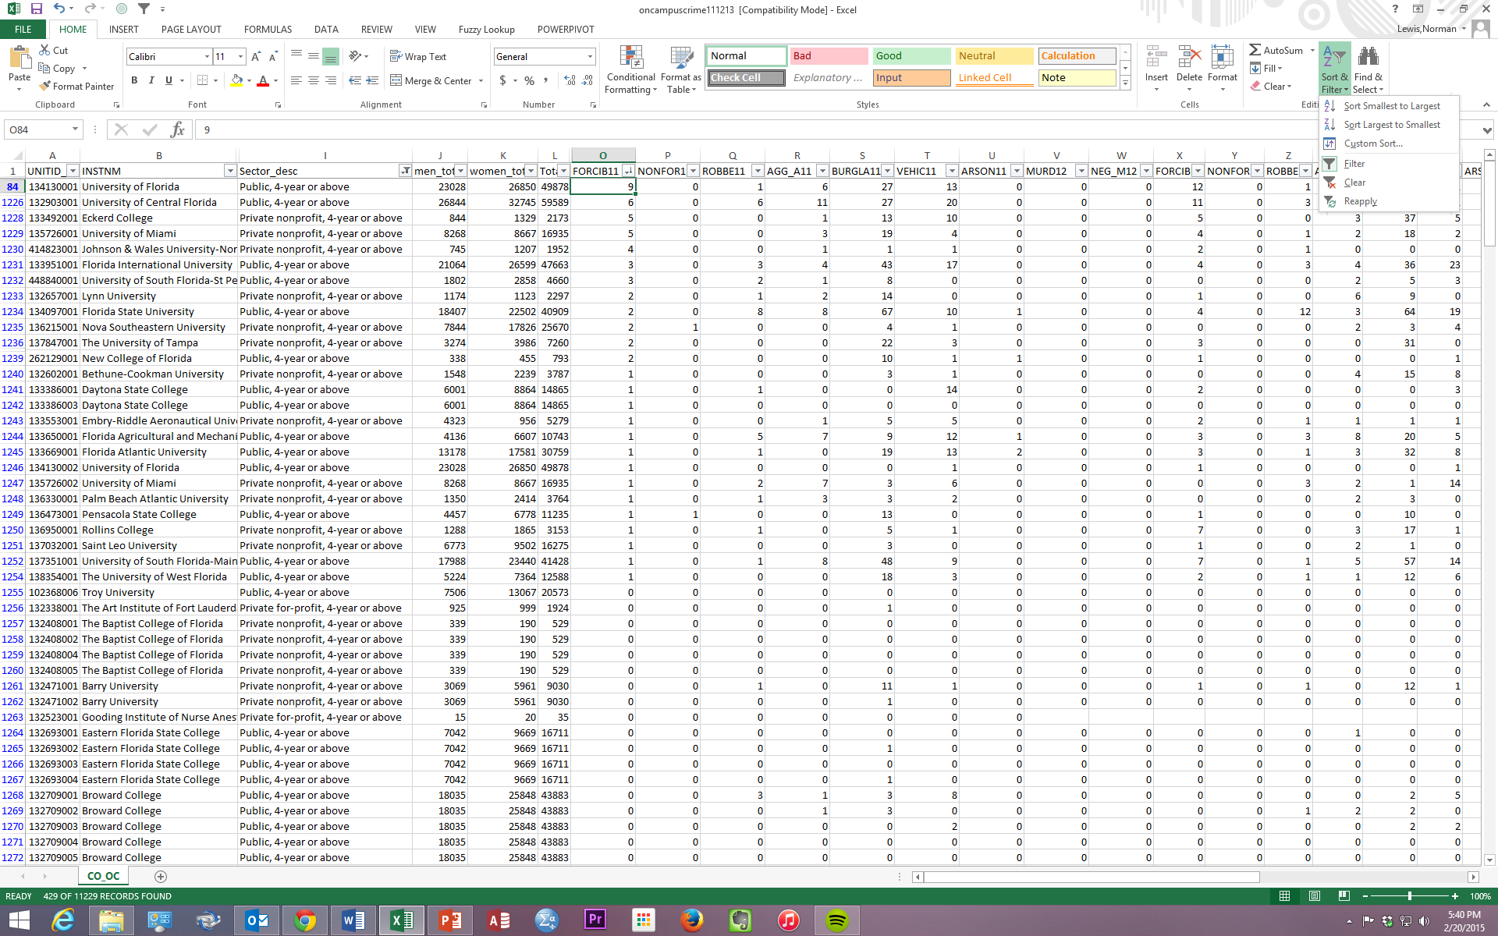
Sort

Slide 24
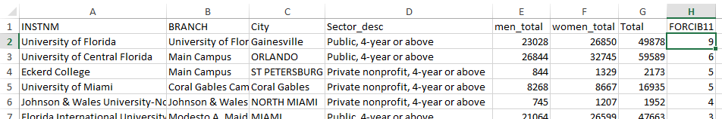

Slide 25
Is one year a fair evaluation?

Slide 26
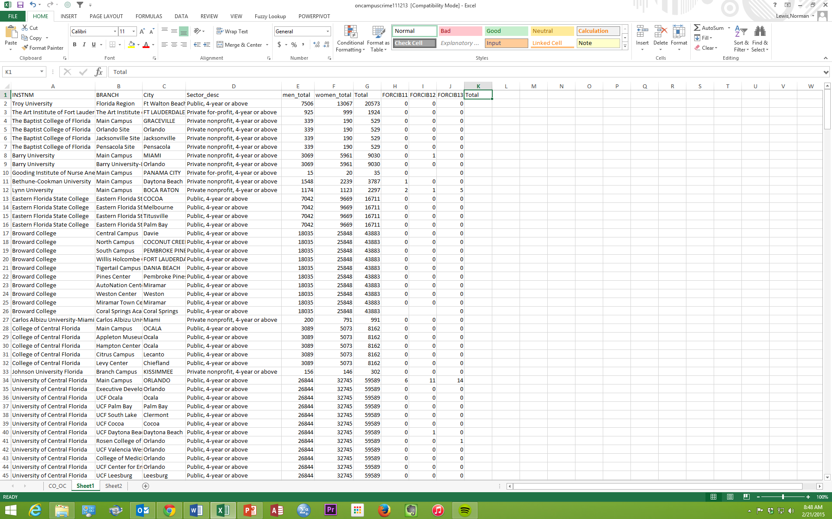
Three years of data

Slide 27
Add Total label

Slide 28
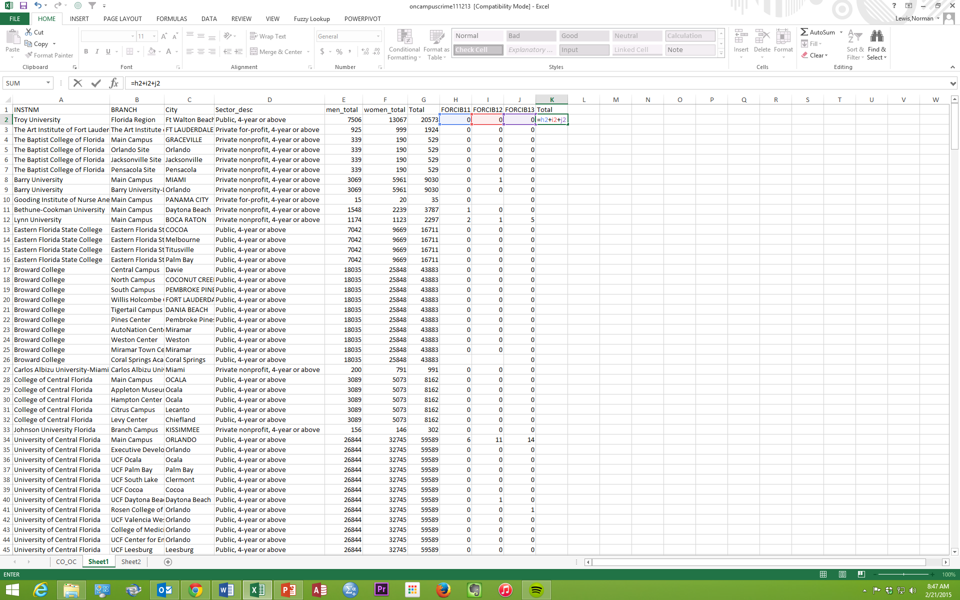
Your first formula

Slide 29

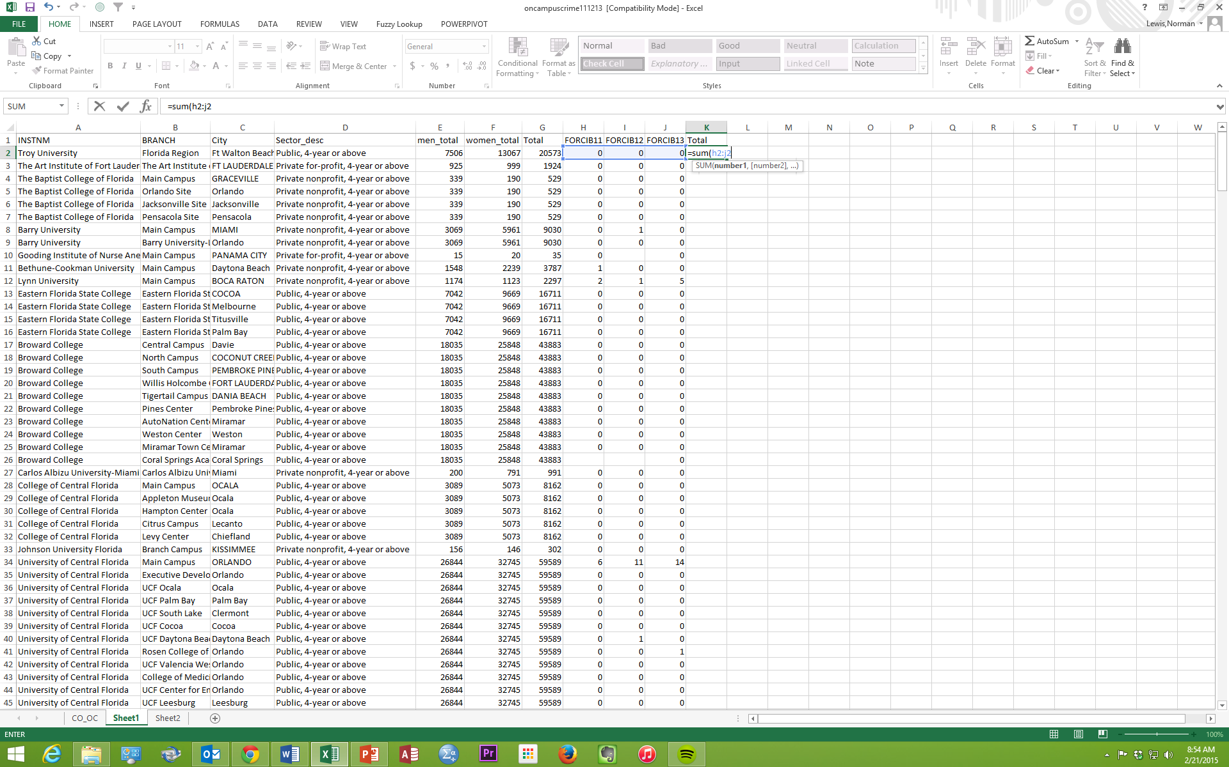
Your first function

Slide 30
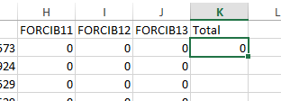
Double-click on green box to fill the formula in all rows

Slide 31
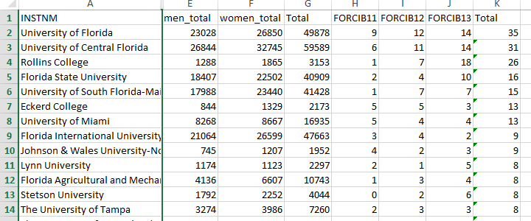
Should we consider enrollment?

Slide 32
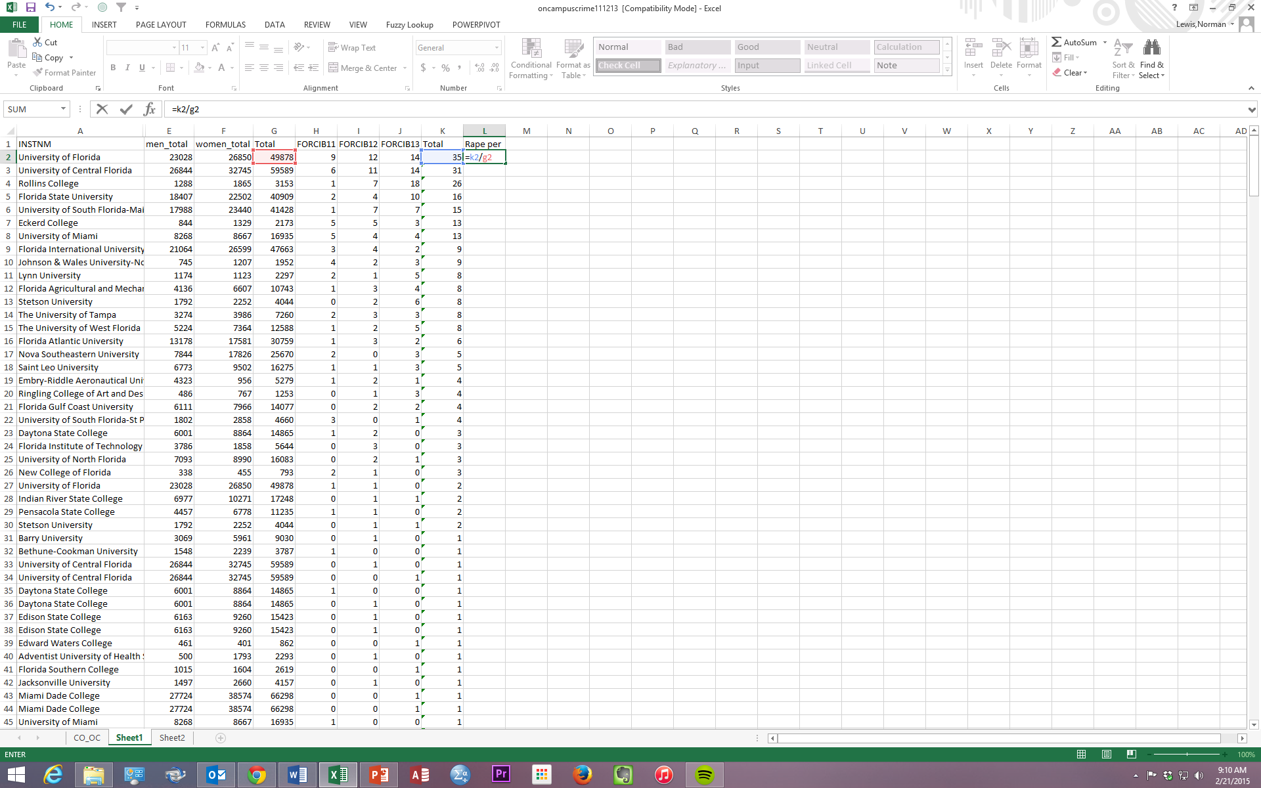
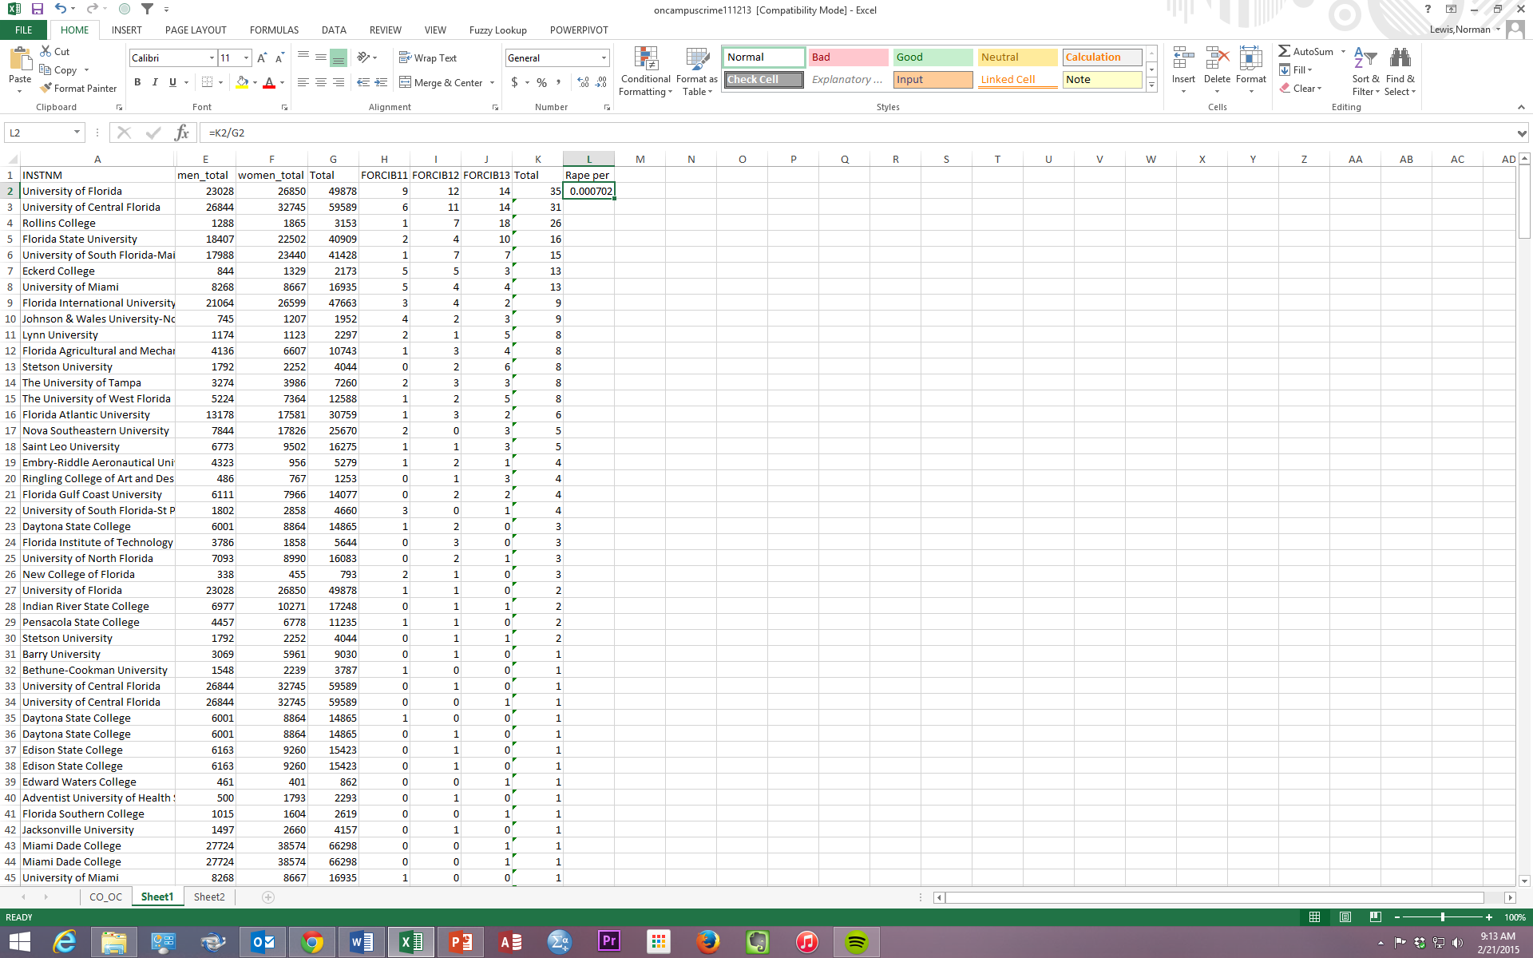

Slide 33

Per 10,000

Slide 34
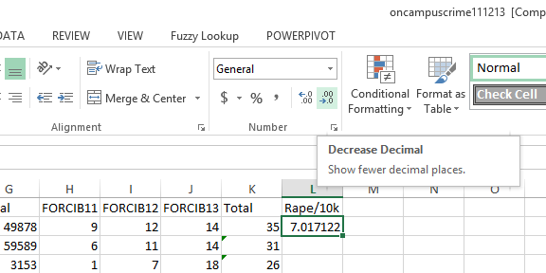
Fill in rows, then sort …

Slide 35
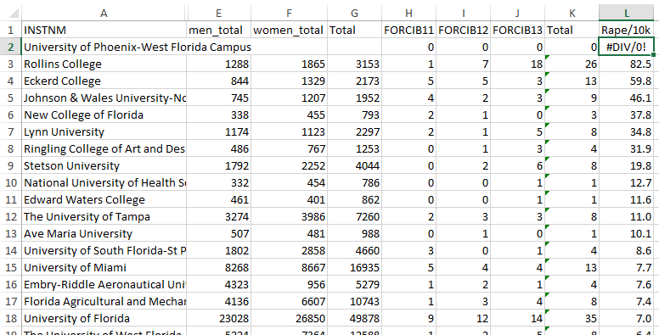

Slide 38

The law of small numbers
The number of murders in Gainesville rose by 50 percent from 2010 to 2011.

Slide 39
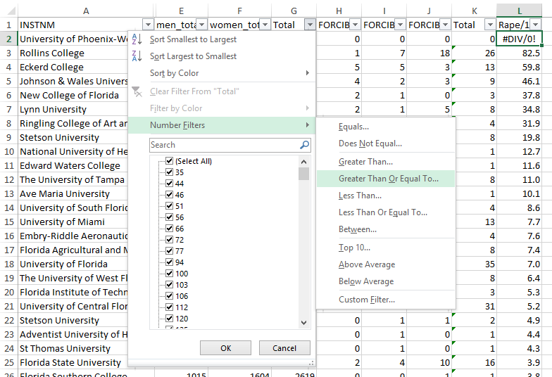
Filter for campuses with at least 10,000 students

Slide 40
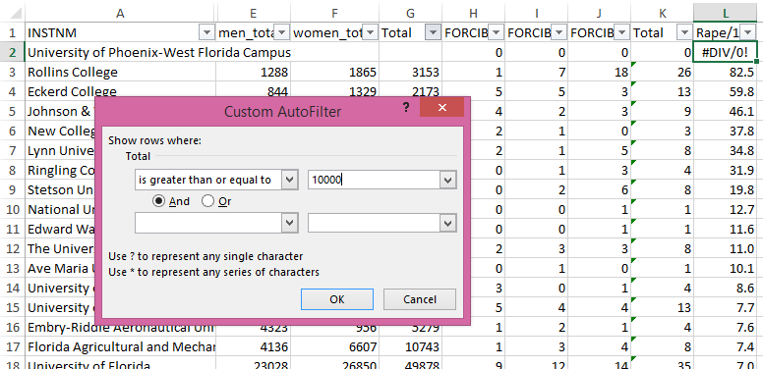

Slide 41
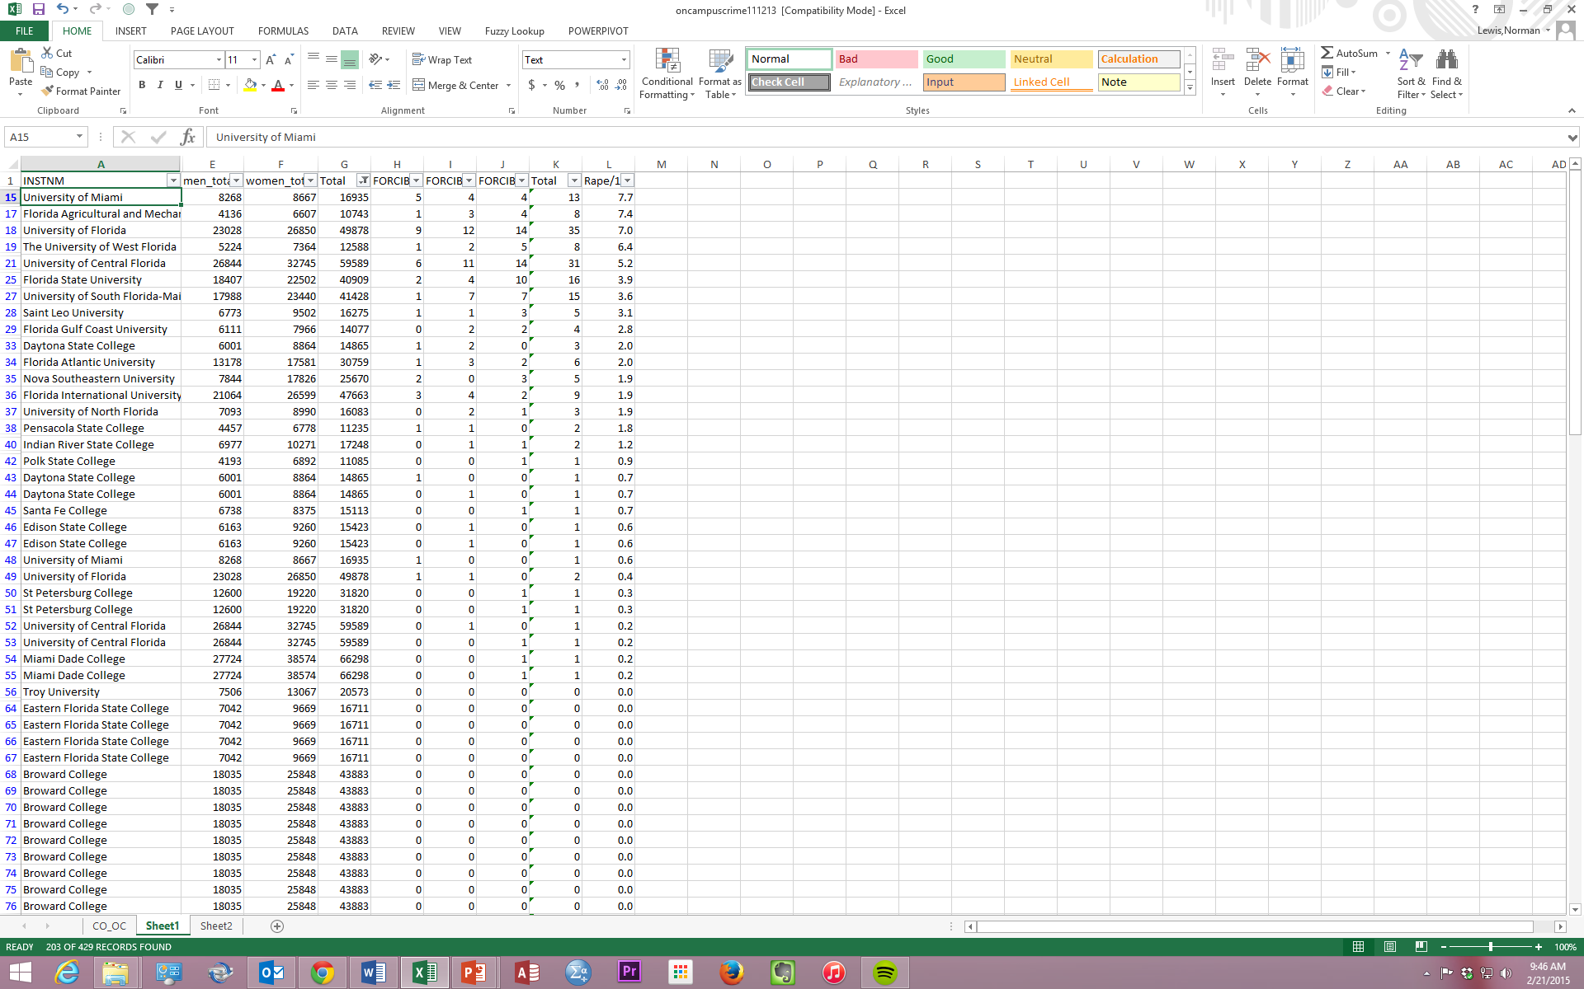

Slide 42
Should we calculate rate based just on women
rather than total student population?

Slide 43
What if we were able to sift residential from commuter universities?

Slide 44
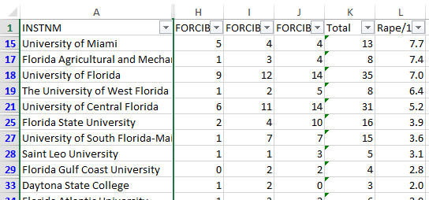
Are these figures complete?

Slide 45
SUMMARY
Use data they care about to help them develop a data frame of mind – to go beyond Excel mechanics to think about what the numbers say and don’t say

Slide 46
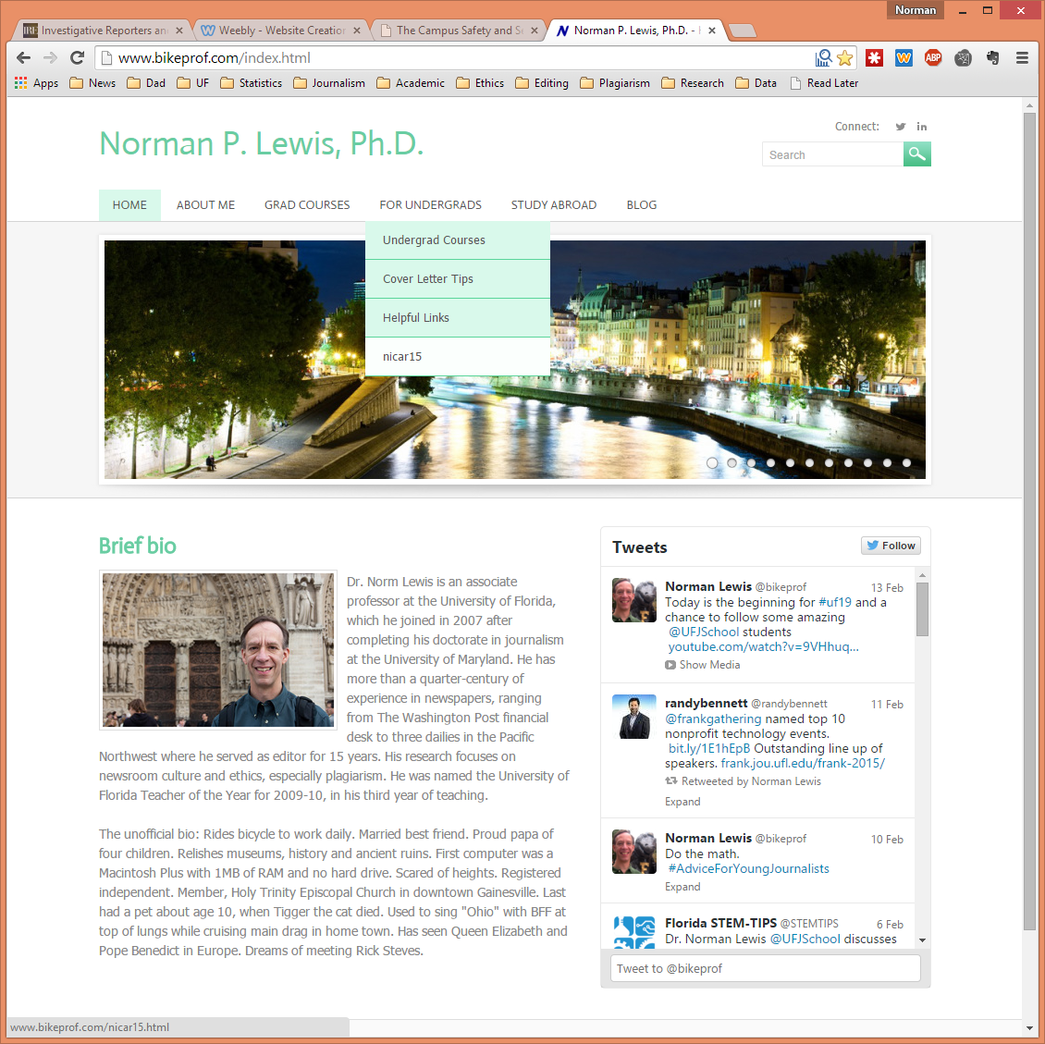
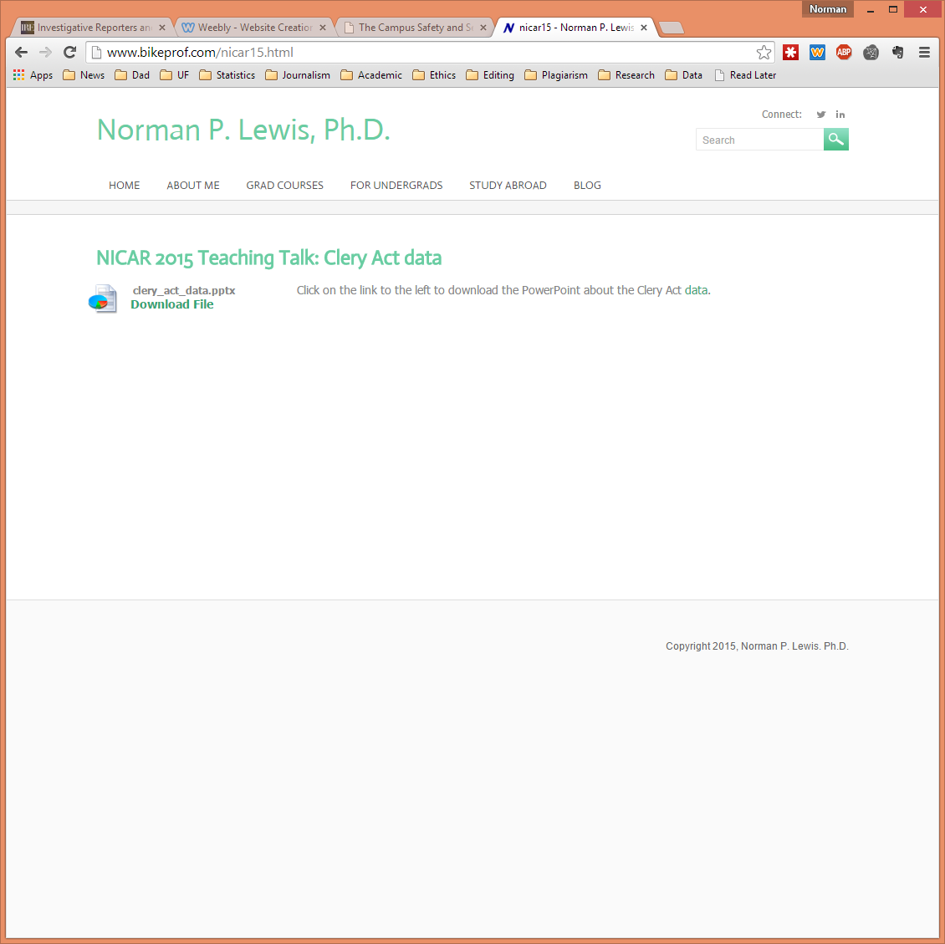
Materials: www.bikeprof.com/nicar15

